Slide 1
K THARUN VIJAY KUMAR
Final Project
3/21/2024 Annual Review

Slide 2
PROJECT TITLE
Handwriting generation with Variational Autoencoders (VAES)
3/21/2024 Annual Review

Slide 3


AGENDA
Encode handwritten characters
Capture variability
Decode into new characters
Conditional generation
Training and evaluation
3/21/2024 Annual Review

Slide 4

PROBLEM STATEMENT
Develop a generative model capable of creating realistic and diverse variations of handwritten characters.
3/21/2024 Annual Review

Slide 5

PROJECT OVERVIEW
Motivation: Handwritten characters hold unique stylistic information and are essential for tasks like document analysis and personalized interactions. However, generating realistic and diverse variations of handwritten characters can be challenging.
3/21/2024 Annual Review

Slide 6

WHO ARE THE END USERS?
Creative Professionals
Font Designers
Graphic Designers
Game Developers
2. Machine Learning Researchers
Data Augmentation
Text-to-Image Synthesis
3/21/2024 Annual Review

Slide 7

YOUR SOLUTION AND ITS VALUE PROPOSITION
1.Solution :-
Enhanced Control with Conditional Input
User-Friendly Interface
Potential Applications for
1) Font Designers
2) Graphic Designers
3) Content Creators
4) Machine Learning Researchers
2.Value Proposition:
Our solution provides a powerful and user-friendly tool for generating realistic and diverse variations of handwritten characters. By offering conditional control and an intuitive interface, it caters to a broad spectrum of users, unlocking creative and practical applications across various fields.
3/21/2024 Annual Review

Slide 8

THE WOW IN YOUR SOLUTION
This solution elevates basic VAE-based handwriting generation by introducing two key advancements:
1. Multimodal Conditional Control:
Text Descriptions
Style Transfer
2. Interactive Exploration and Control:
Latent Space Navigation
Real-Time Feedback
3/21/2024 Annual Review
8

Slide 9
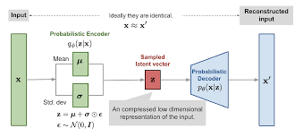
MODELLING
Teams cam add wireframes
3/21/2024 Annual Review
9

Slide 10
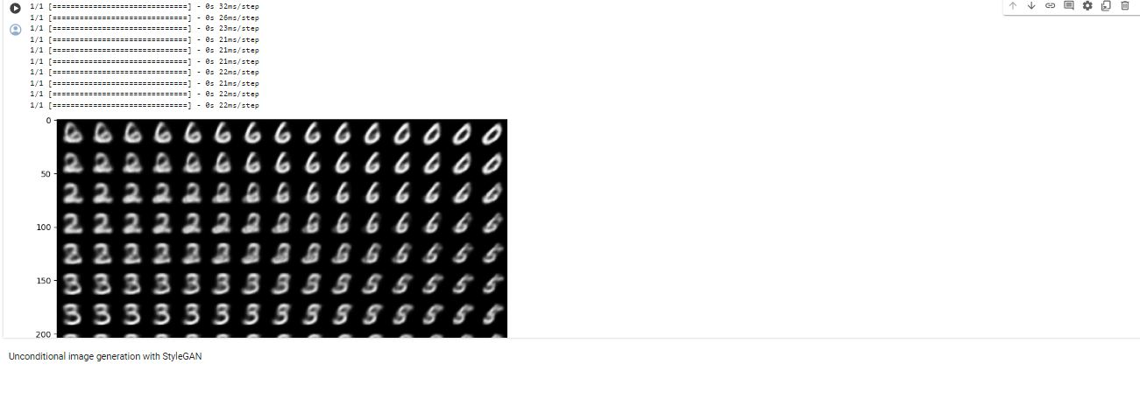
RESULTS
Thus execution of Handwriting generation with Variational Autoencoders (VAEs) is successfully done.
Demo Link
3/21/2024 Annual Review
10

